Slide 1

APPLE STOCK FORECASTING
Team 1:-
Amisha Yadav
Prajwal Sonawale
Akshay Shinde
Vivek Tawalare
Mujahid Bagwan
Harneet Kaur Ghai
Mentor:-
Neha Gupta

Slide 2
Problem Statement:
Predict the apple stock market price for next 30 days.
There are Open, High, Low and Close price has been given for each day starting from 2012 to 2019 for Apple stock
Objective:
Predicting the apple stock market price for next 30 days. .
To predict model which will give the best accuracy.

Slide 3
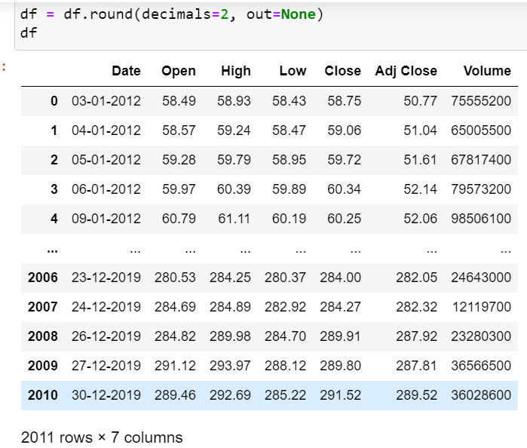
Project Flow:-
Data

Slide 4
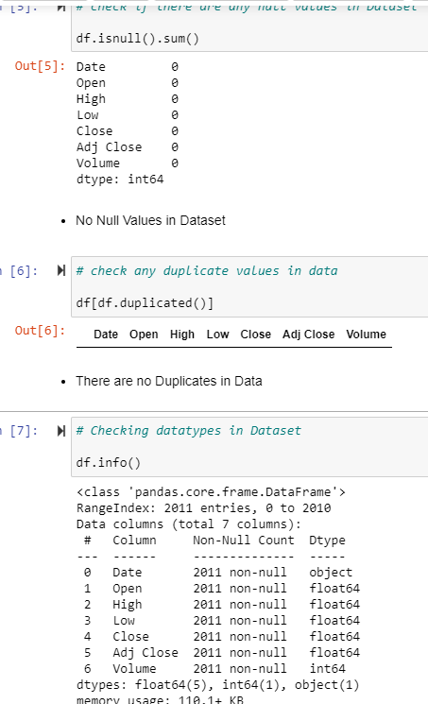
EDA Now let’s start exploring the dataset.
From the isnull function we got to know about there are no missing value, and from df.duplicated , that data is free from duplicate value. From info function we got to know about data types of all columns.

Slide 5
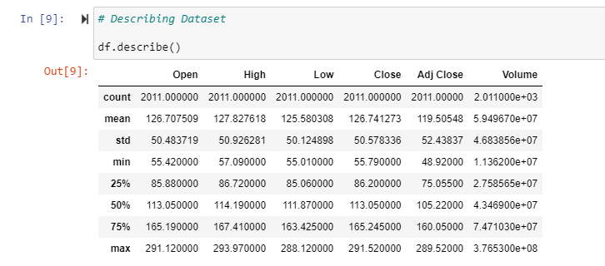
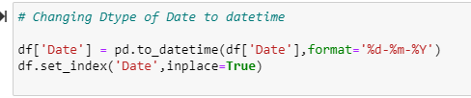
From the describe function we got to know about the mean, medium, standard deviation of our dataset. The data is normally distributed as mean and medium range is close to each other. Also we change the date time.

Slide 6
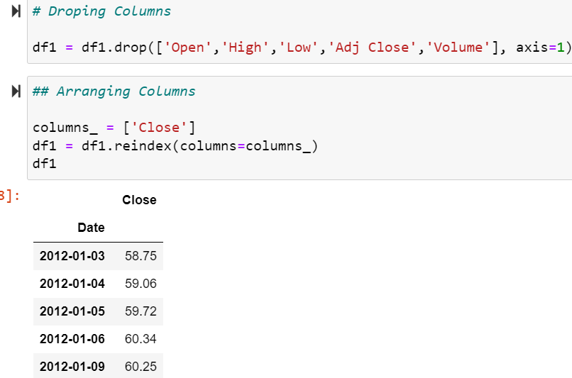
Then We have drop columns and reindex the date column.

Slide 7
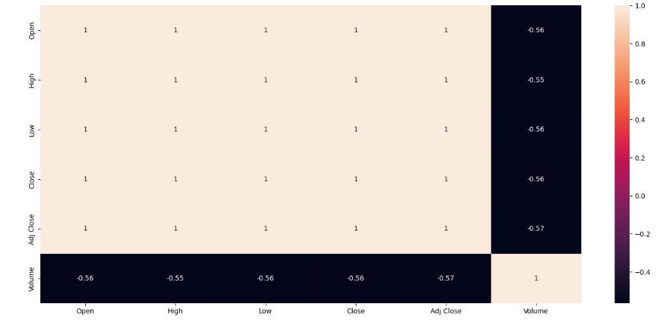
Visualization of our data
Firstly to see the correlations between dependent and independent columns.
Through correlation matrix, we can observe that there is high level of correlation with Open, Low, High and Closing prices.

Slide 8
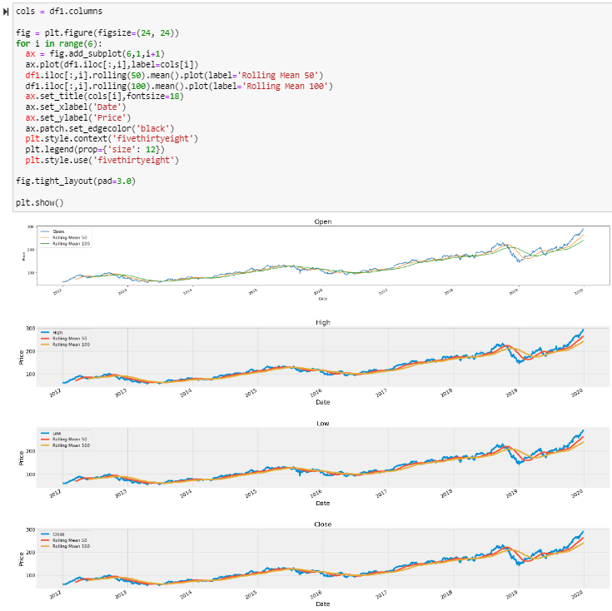
From this subplot, we are able to see each year how all columns are having rolling mean 50, 100. How the graph is showing the pattern of all columns having variation according to years.

Slide 9
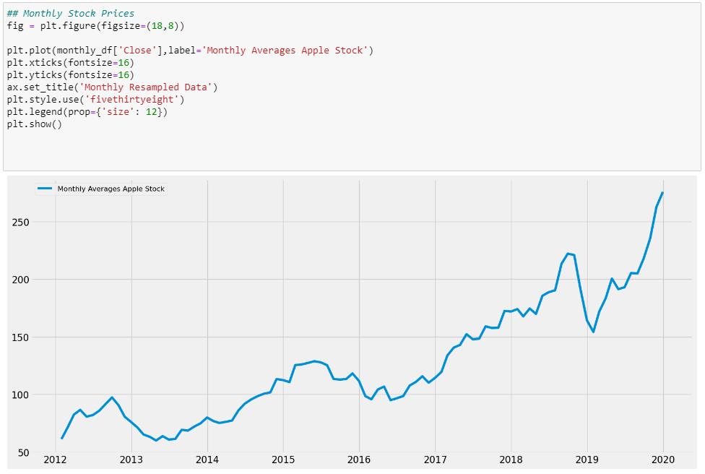
We checked monthly stock price of each year by plotting line plot.

Slide 10
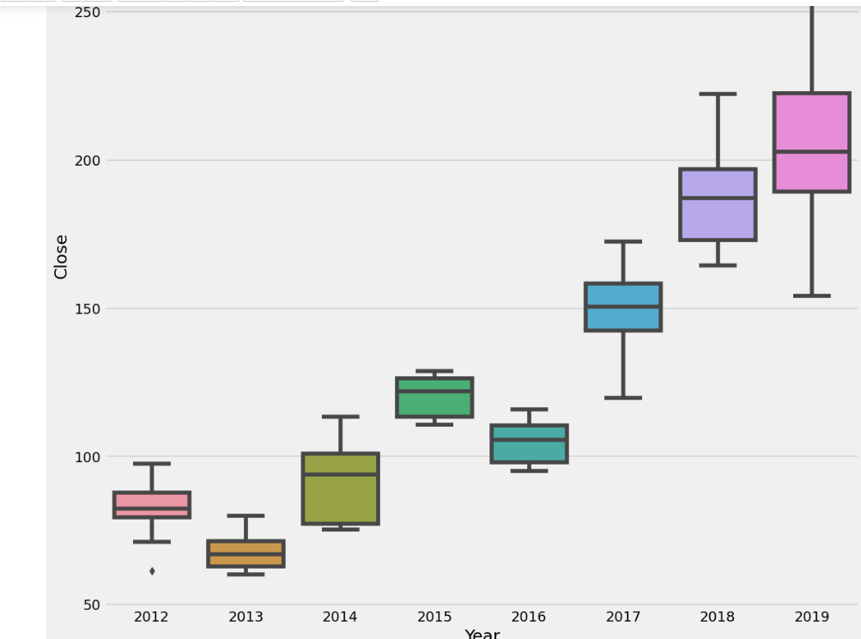
Boxplot of each year representing variation in prices

Slide 11
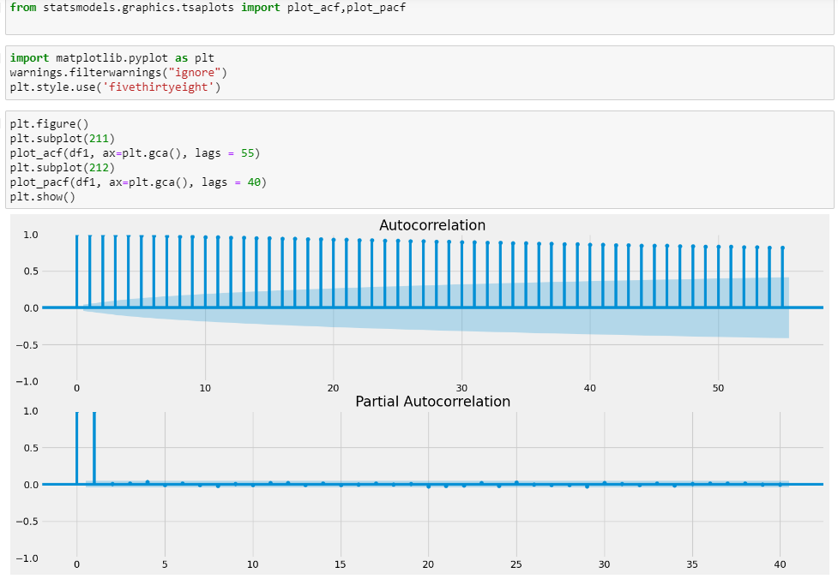
We plotted acf and pacf to find out the trend in our dataset. the ACF/PACF plots will show a quick drop-off in correlation after a small amount of lag between points. This data is non-stationary as a high number of previous observations are correlated with future values.

Slide 12
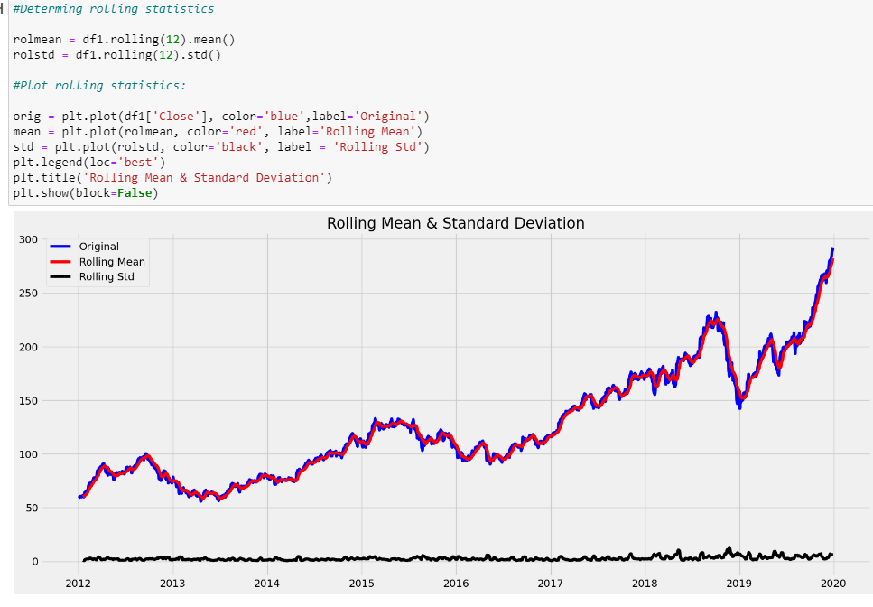
We can plot the moving average or moving variance and see if it varies with time. Moving average/variance is for any instant ‘t’, the average/variance of the last year, i.e. last 12 months.

Slide 13
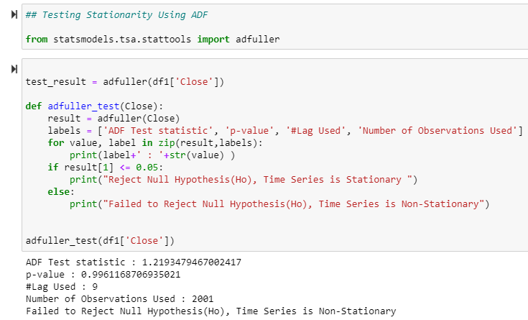
Statistically verified by ADF Test- that we failed to Reject Null Hypothesis(Ho) our Time Series is Non-Stationary and as observed earlier also by Decomposition(Trend and Seasonality Present)

Slide 14
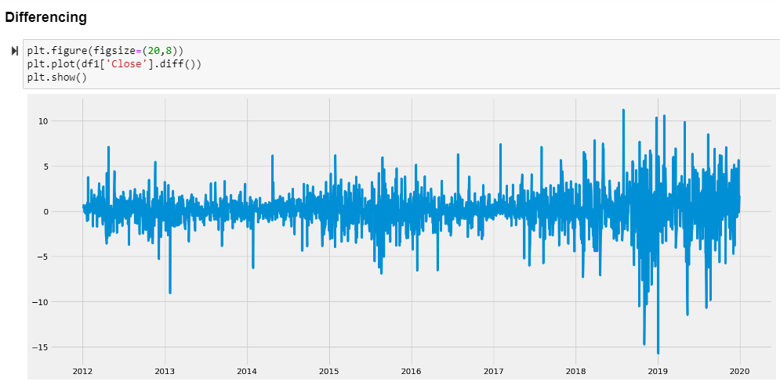

Slide 15
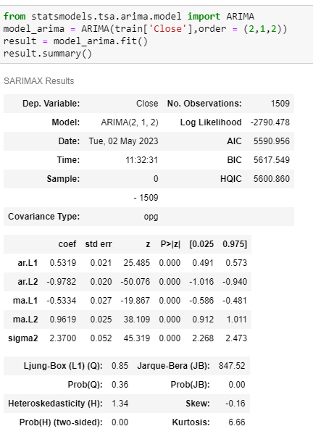
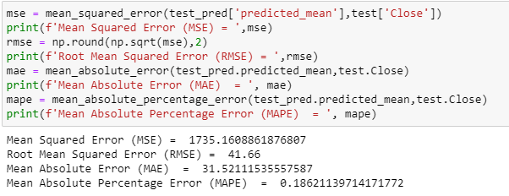
We build Arima model, but the accuracy and error mape, mse was showing more. So we got to know that there is seasonality in our dataset. So, we have to go with Sarima model.

Slide 16
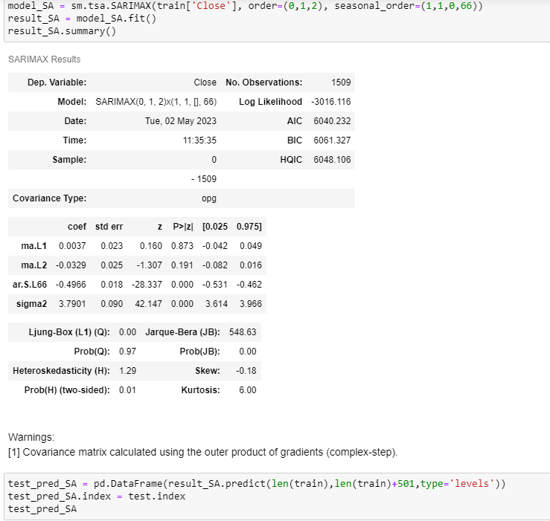
Model Building
We have select Sarima as our final model as our data had seasonality .

Slide 17
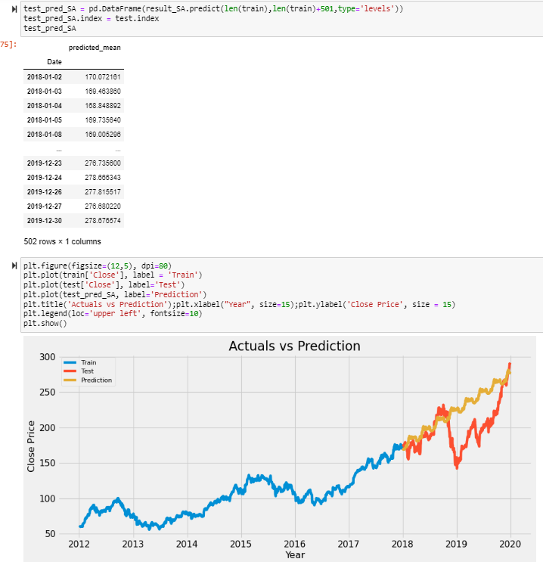
Then we predict the model using train test split. And compared the prediction with actual data.

Slide 18
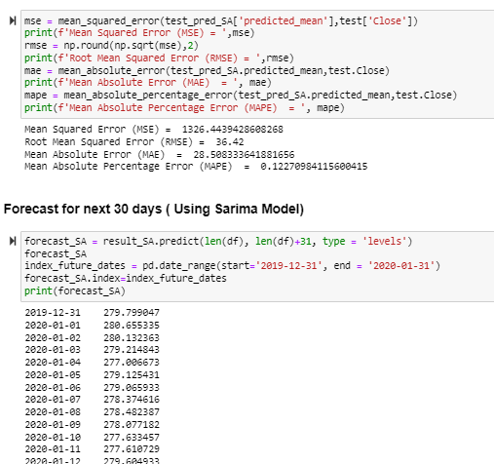
Forecast for next 30 Days
We checked the mse, and mape value , it was less and then we predicted the next 30 days stock price.

Slide 19
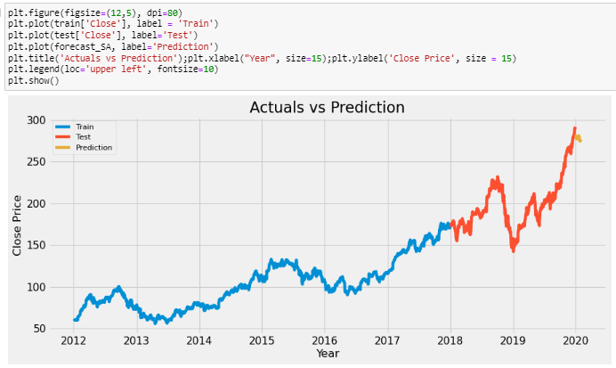
After predicting the apple stock price for next 30 days, we can see the trend in the graph.

Slide 20
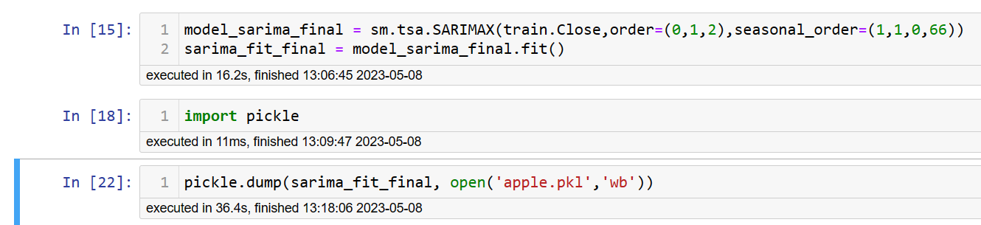
Model Deployment using Stream lit method
We used Stream lit for deployment of our Project Apple Stock Forecasting.
First we developed model in Python using Sarima Model.
Then using pickle library we exported model in required format.
We developed front end in Spyder using python language.
Below are the screenshots of 1. Sarima model
2. Front end coding
3. Front end.

Slide 21
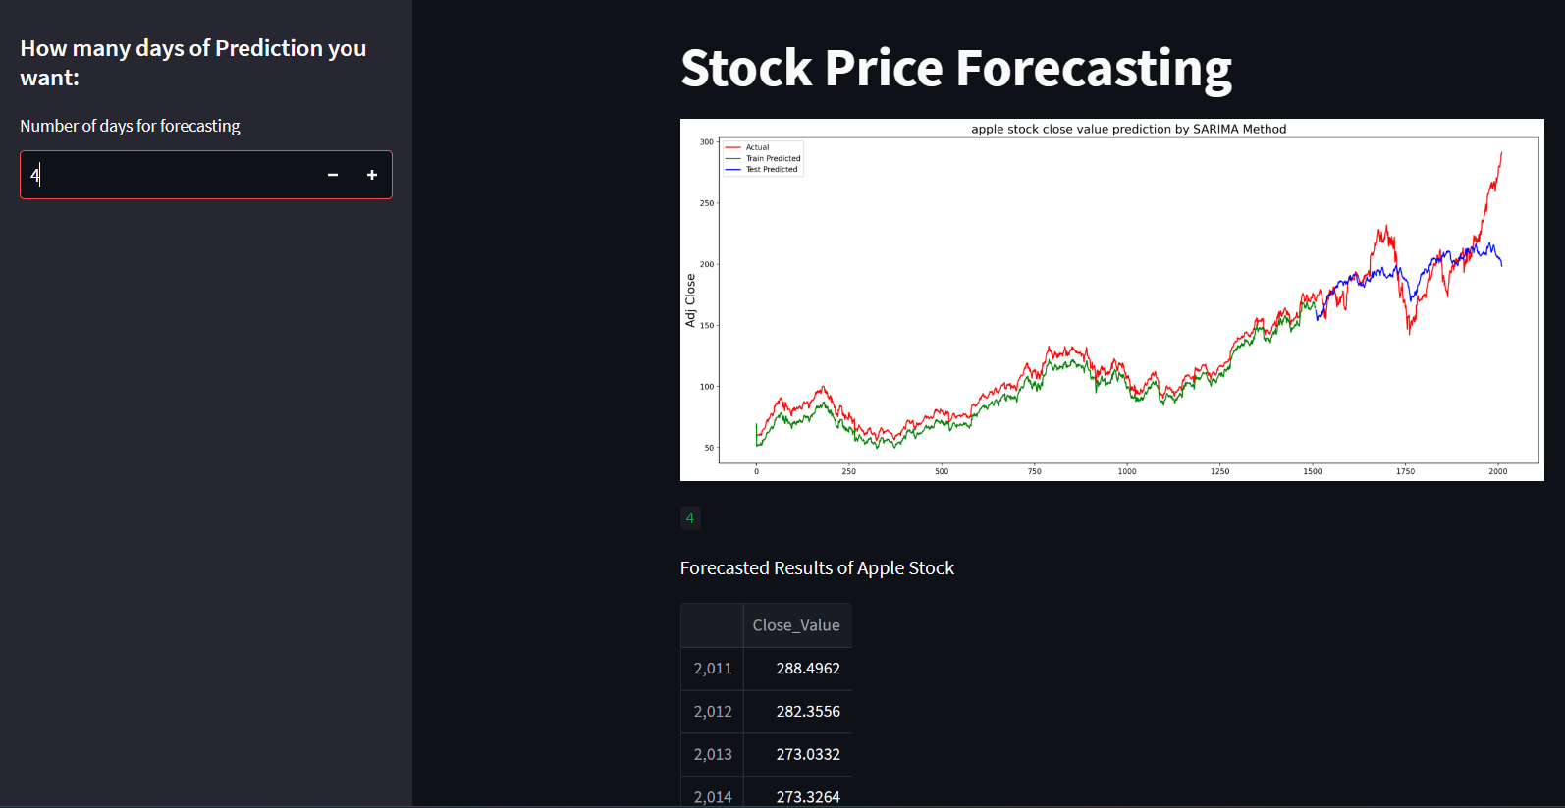

Slide 22
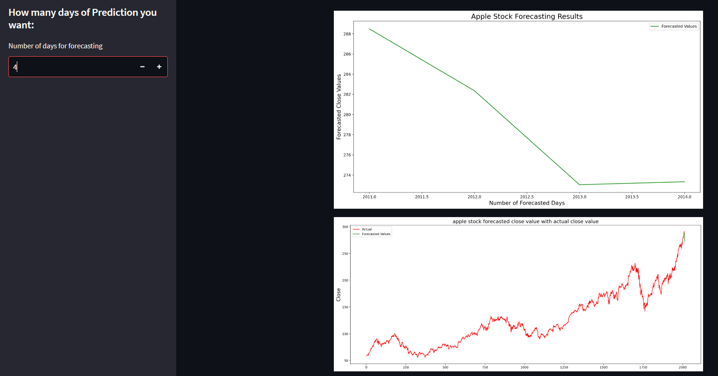

Slide 23
Obstacles encountered and how we found solution for it.
While Model building, the error and accuracy was a problem to overcome, we did solved that by changing sarima model parameters
While Deploying Model, representing graph was also an issue we faced, but later we solved that using matplotlib plyplot.

Slide 24
Thank you

